Slide 1
Active Learning: Definition and Concepts
The main hypothesis in active learning is that if a learning algorithm can choose the data it wants to learn from, it can perform better than traditional methods with substantially less data for training.

Slide 2
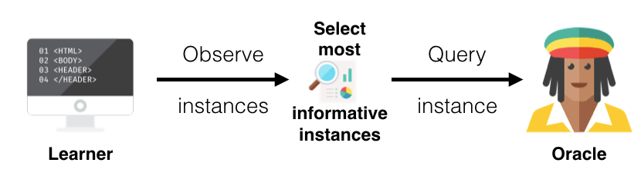
Scenarios
Pool-Based sampling

Slide 3
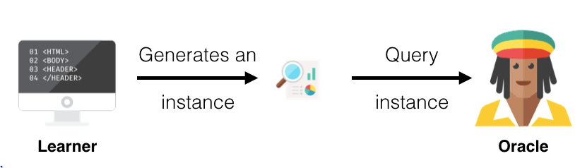
Membership Query Synthesis

Slide 4
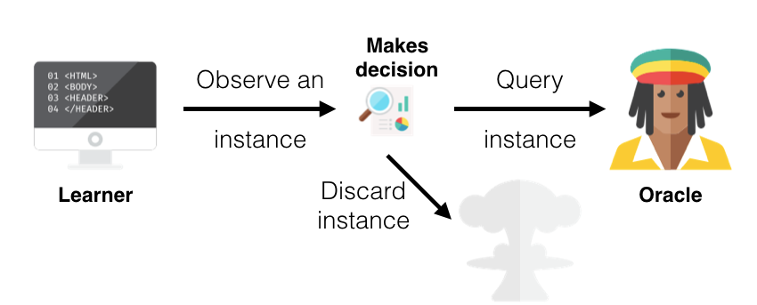
Stream-Based Selective Sampling

Slide 5
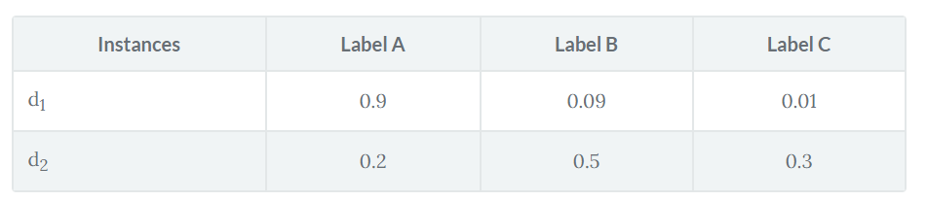
Query Strategies
Least Confidence (LC)
Margin Sampling
Entropy Sampling

Slide 6
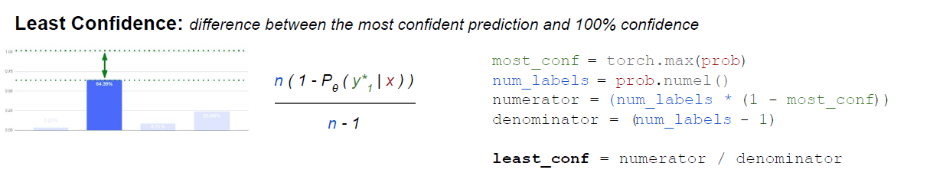
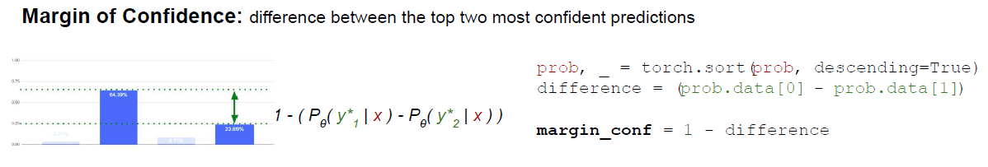
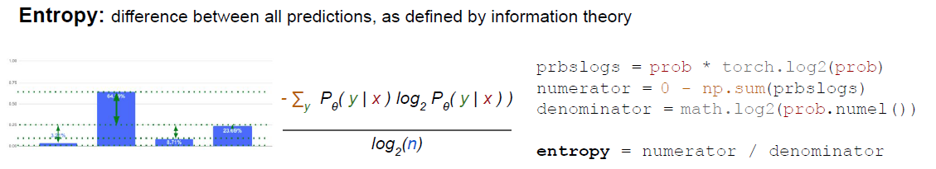

Slide 7
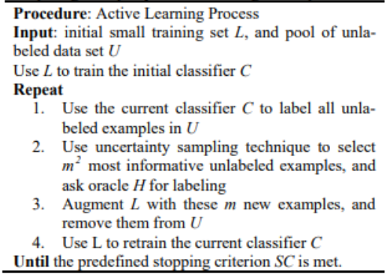
Active learning process

Slide 8
Refrences
https://www.datacamp.com/community/tutorials/active-learning
https://www.aclweb.org/anthology/C08-1143
http://robertmunro.com/Uncertainty_Sampling_Cheatsheet_PyTorch.pdf

